Slide 1
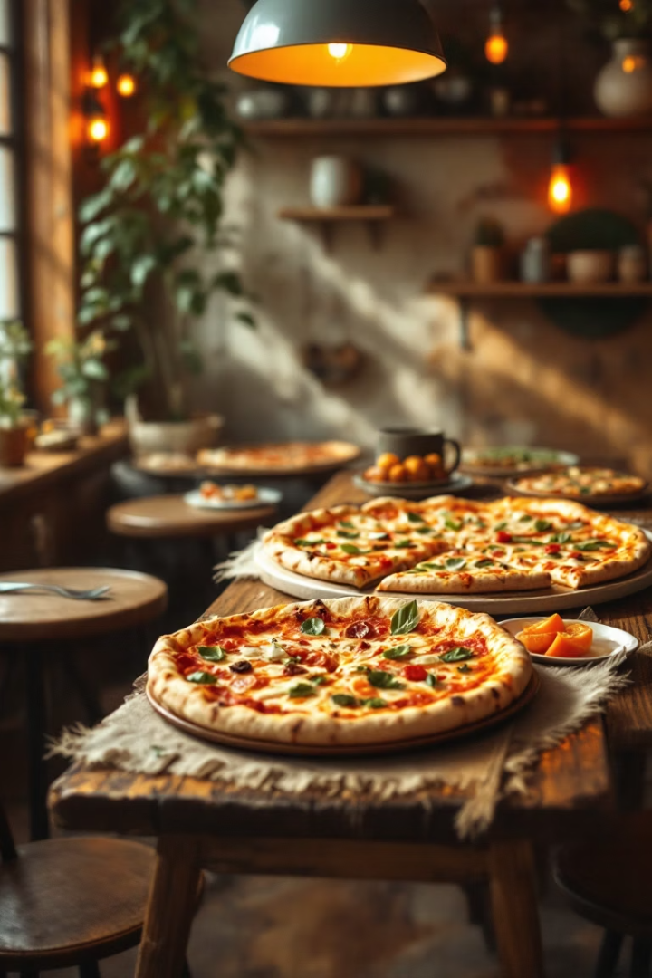

Pizza Sales Performance Dashboard
UNIFIED MENTOR PROJECT
Project Submission by Rakhi Chakrabarty, April 2025
Email ID – rakhichakrabarty8@gmail.com
by Rakhi Chakrabarty

Slide 2

Project Introduction
Objective
Uncover key sales patterns and trends
Data Source
Pizza sales dataset covering full year
Tools Used
Tableau Public for interactive dashboard
Approach
Professional filtering, layout, insights generation

Slide 3
Dataset Overview
Key Fields
Coverage
Order ID, Date and Time
Transactions across different pizza types and sizes
Pizza Name and Size
Data spans an entire year of sales
Quantity, Total Price

Slide 4
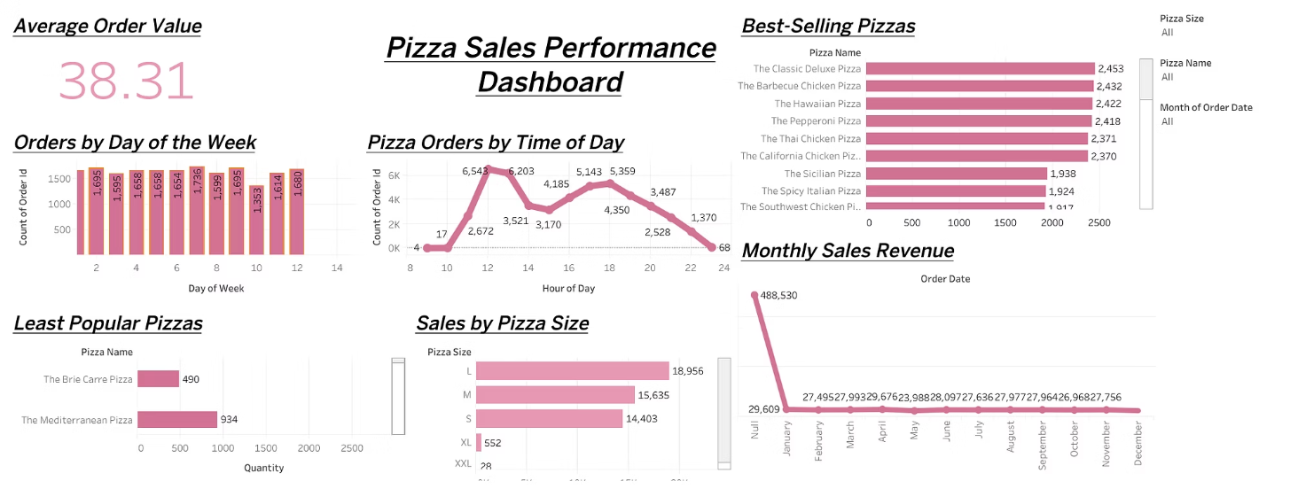
Dashboard Overview
The Tableau dashboard features real-time filters:
Pizza size
Pizza name
Monthly sales

Slide 5
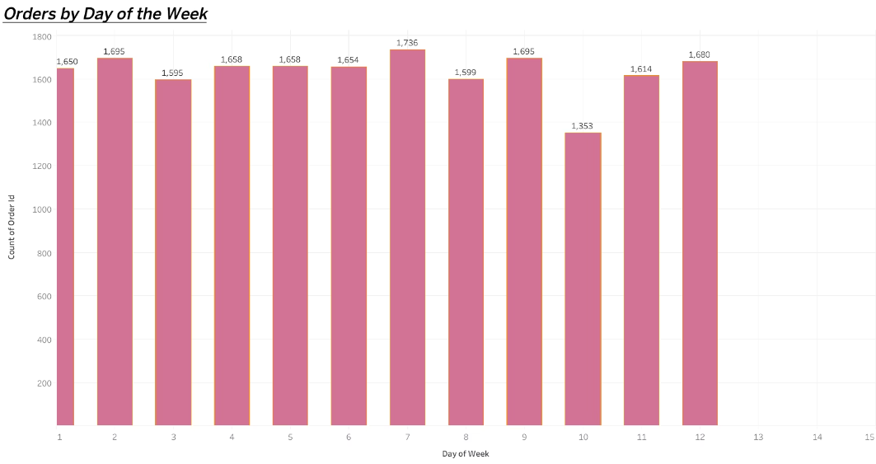
Orders by Day of the Week
Weekend Spike
Low Midweek
Staffing & Marketing
Friday and Saturday have highest orders
Tuesday and Wednesday show reduced volume
Focus resources on weekends for impact

Slide 6
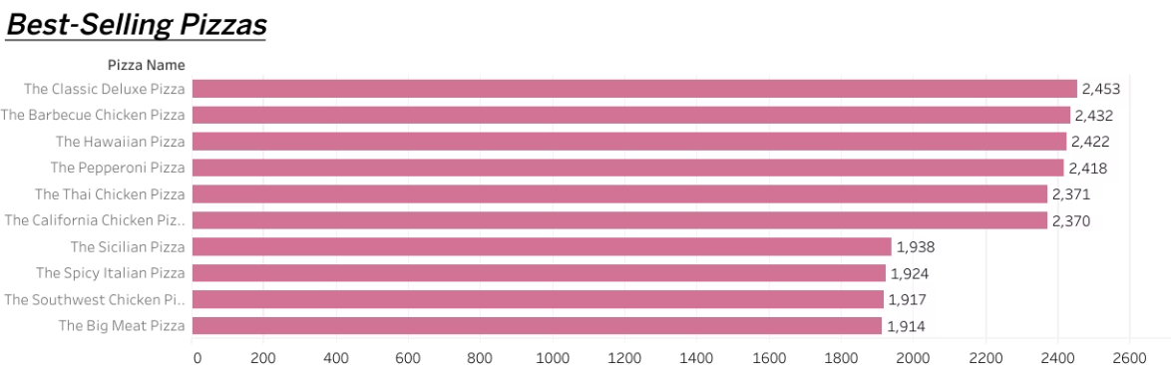
Best-Selling Pizzas
Classic Deluxe Pizza tops sales
Hawaiian and Pepperoni also strong
Barbecue Chicken Pizza follows closely
Target promotions around these key pizzas

Slide 7
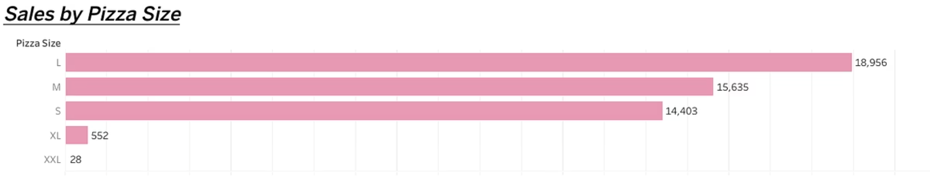
Sales by Pizza Size
Large Favorites
Medium Moderate
Large pizzas have highest sales volume
Medium sizes perform well
Smaller Sales
Upselling Potential
Small pizzas have lowest sales
Encourage upgrades to larger sizes

Slide 8
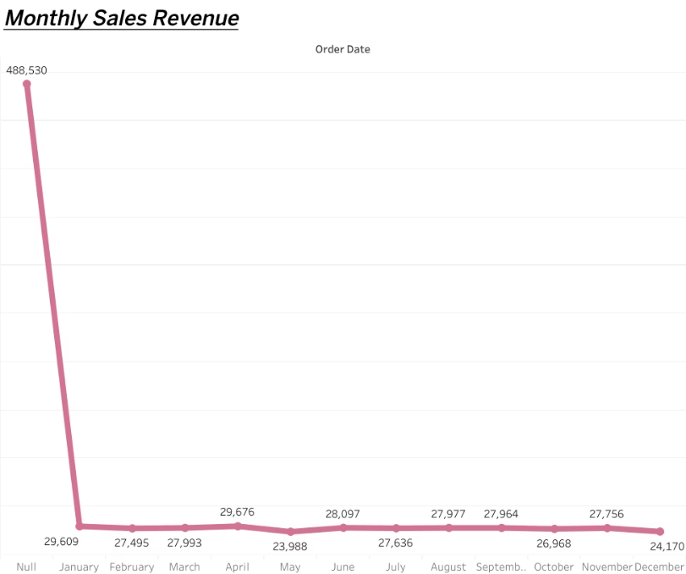
Monthly Pizza Sales Analysis
January spike: $488,530 revenue
December lowest sales: seasonality effect
Feb-Dec: stable $27K-$30K avg sales
Plan campaigns to address dips

Slide 9

Additional Observations
Order Peaks
Lunch and early dinner (12–6 PM) highest volume
Seasonal Effects
January revenue spike linked to holidays/offers
Low Popularity Items
Some pizzas like Brie Carre have poor sales
Menu Optimization
Consider revising or removing low-sale pizzas

Slide 10






Key Recommendations
Promote Best Sellers
Combine offers on Classic Deluxe and Barbecue Chicken
Increase Midweek Sales
Introduce Tuesday-Wednesday discounts and loyalty rewards
Boost December Sales
Run year-end marketing like Holiday Pizza Offers
Time-Based Deals
Launch Lunch Hour Specials and Evening Deals
Inventory Focus
Stock more Large size pizzas due to demand
Expand Customer Base
Use tasting bundles to promote less popular pizzas

Slide 11
Conclusion
Based on the analysis:
Marketing efforts should focus on promoting best-selling pizzas during weekend evenings.
Staff scheduling should be adjusted to handle peak order times effectively.
Upselling large pizzas can help maximize revenue.
Seasonal campaigns should be reinforced during January and holiday periods.

Slide 12
…………Thank You…………..

